Slide 1
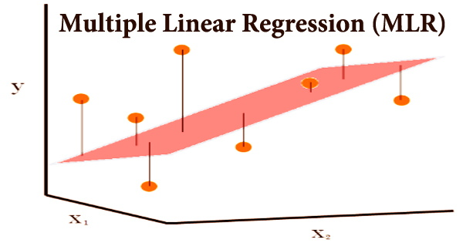
Project 2: Multiple Linear Regression on Advertising Dataset
Coding Samurai Internship
Created by:-Saniya Shaikh

Slide 2
Objective
To build a multiple linear regression model that predicts Sales based on three advertising channels — TV, Radio, and Newspaper.
This project focuses on:
Understanding regression modeling
Generating synthetic dataset
Evaluating prediction performance
Visualizing relationships between variables

Slide 3
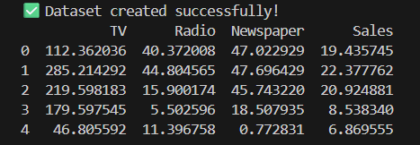
Dataset Used
Created a synthetic advertising dataset using NumPy.
Rows: 120
Columns: TV, Radio, Newspaper, Sales
Type: Numeric, continuous
Noise: Added random noise for realism
Formula used to generate Sales :
Sales = 3 + 0.045*TV + 0.18*Radio + 0.02*Newspaper + noise

Slide 4
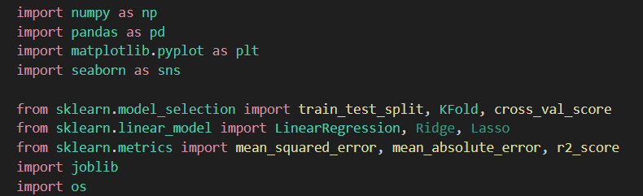
Tools Used
Python, Pandas, NumPy, Seaborn, Matplotlib, Scikit-Learn

Slide 5
Steps Performed
Created DataFrame using Pandas
Checked summary statistics (df.describe())
Checked missing values (df.isnull().sum())
Generated correlation matrix (df.corr())
Used Seaborn pairplot to visualize relationships

Slide 6
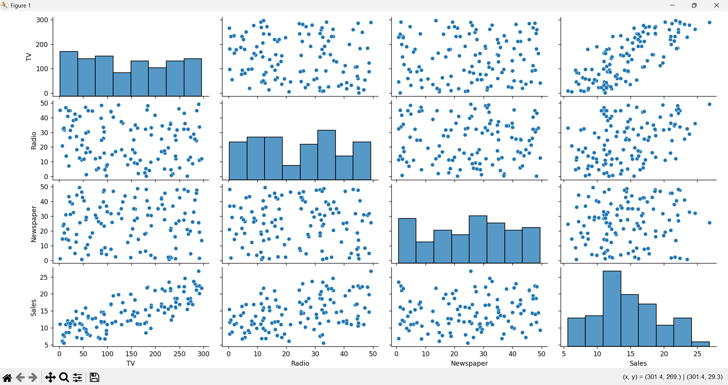
Pair Plot (Scatterplot Matrix)

Slide 7
Splitting the Data
Train/Test Split:
80% Training — 96 samples
20% Testing — 24 samples
Used Scikit-Learn:
X_train, X_test, y_train, y_test = train_test_split(
X, y, test_size=0.2, random_state=42
)

Slide 8
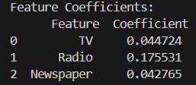
Model Training
Model Used: LinearRegression()
Fitted using TV, Radio, Newspaper as features
Extracted model intercept & coefficients
Coefficients Learned:
TV → small positive influence
Radio → strongest influence
Newspaper → weaker influence

Slide 9
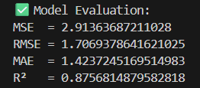
Model Evaluation

Slide 10
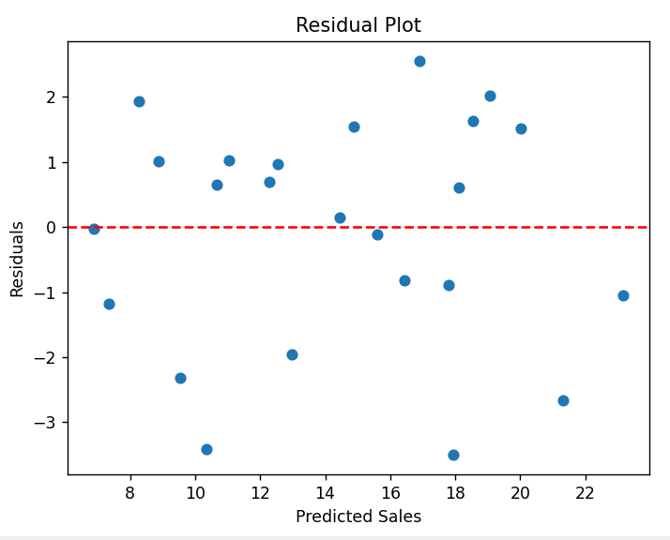
Residual Analysis
Residual plot used to check error distribution:
Residuals are scattered around 0
No major pattern → good linear fit

Slide 11
Cross-Validation
Used 5-Fold KFold CV
cv_scores = cross_val_score(model, X, y, cv=kf, scoring='r2')
Meaning:
Model is stable, generalizes well across folds.

Slide 12
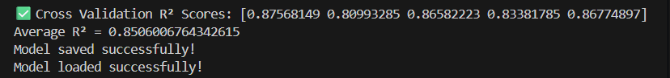
Model Saving
Saved the trained model using Joblib:

Slide 13
Results & Insights
Successfully built a multiple linear regression model
Understood how each advertising medium impacts sales
Performed evaluation + visual diagnostics
Implemented cross-validation
Exported final trained model safely

Slide 14

Thank You

